Slide 1
Final Project
Credit Card Default Prediction
By: Nicholas Wofford
Jyoti Swaroop Naidu Yelaka Amarnath Reddy Chinthapalli

Slide 2
Contents
Introduction
Project Idea
Training Data
Feature Engineering
Model Training / Hosting
Backend
Frontend
Errors
Conclusion

Slide 3
Credit-Card-Default-Prediction
Project Scope:
The goal of this project is to make a user-interactive application that will allow a user to input information regarding their credit usage and payments and predict if they are likely to default on their payments in the future.
Project Domain:
Financial Risk Assessment - By predicting potential defaults, financial institutions can take proactive measures, thereby reducing losses and better managing risks.
AWS Tools to use:
Amazon S3, Amazon SageMaker, Amazon Api Gateway, Amazon Lambda

Slide 4
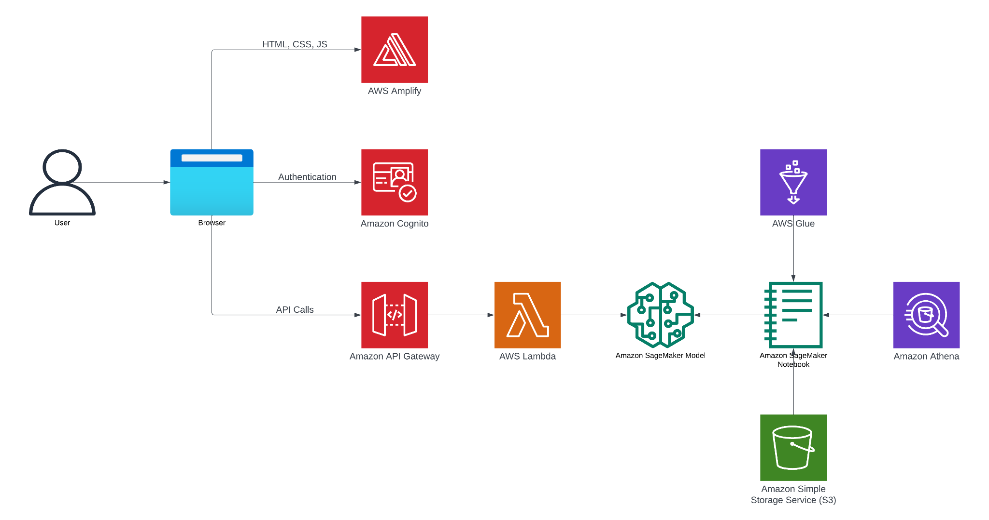
Project Idea
This project is intended to be a demonstration of several AWS technologies to create a user interactive predictive model for credit card defaults.

Slide 5
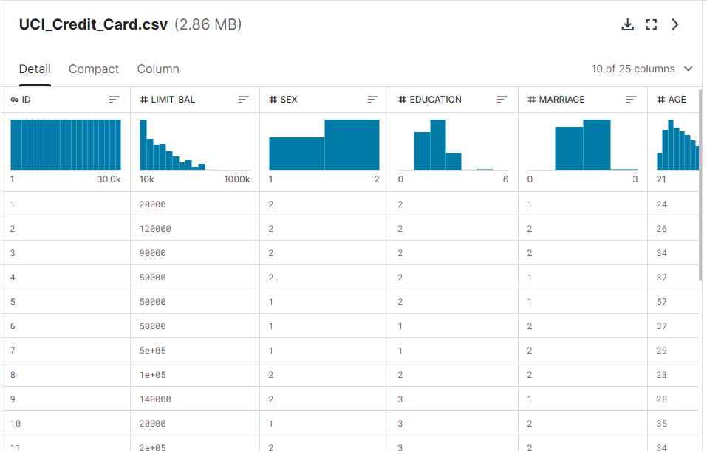
Training Data
https://www.kaggle.com/datasets/uciml/default-of-credit-card-clients-dataset
30,000 Records
24 features
Collected 2005

Slide 6
Feature Engineering
Feature engineering done with AWS sagemaker, the dataset was complete with no null values. All data engineering that was done was to improve the accuracy of the model. This includes dropping non-essential columns such as ID and one-hot encoding.
Full data preprocessing file can be found here

Slide 7
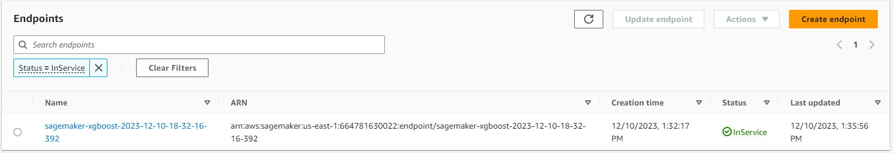
Model Training / Hosting
The model we decided to go with was an XGBoost model as we are dealing with a binary classification problem.
The model was trained on sagemaker and is hosted as an endpoint which can be accessed with the amazon SDK.

Slide 8
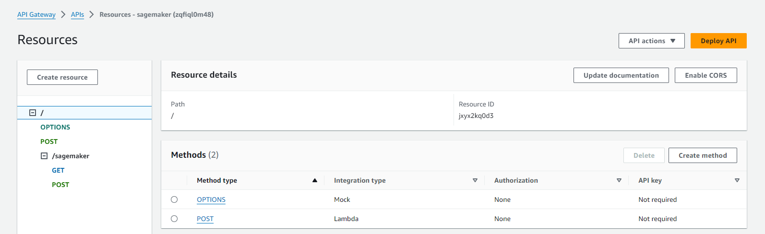
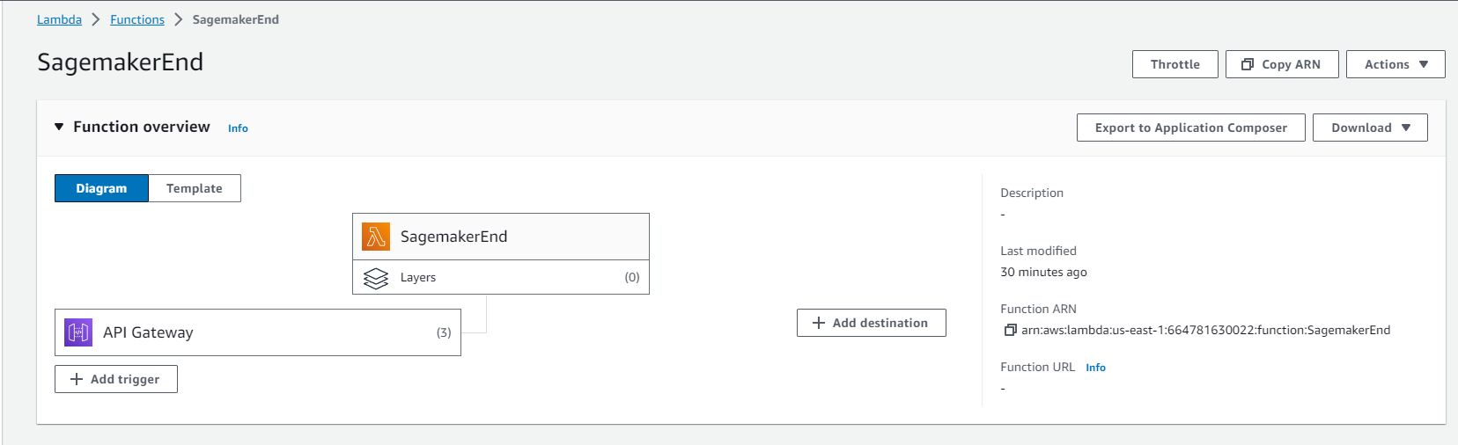
Backend
The backend of this application uses two AWS products: AWS api gateway and AWS Lambda.
These two applications work in conjunction to allow for communication with api requests over the web.
The API gateway allows for a link that a request can be sent to, one the request is sent the Lambda function is invoked which calls the sagemaker endpoint to get the result.

Slide 9
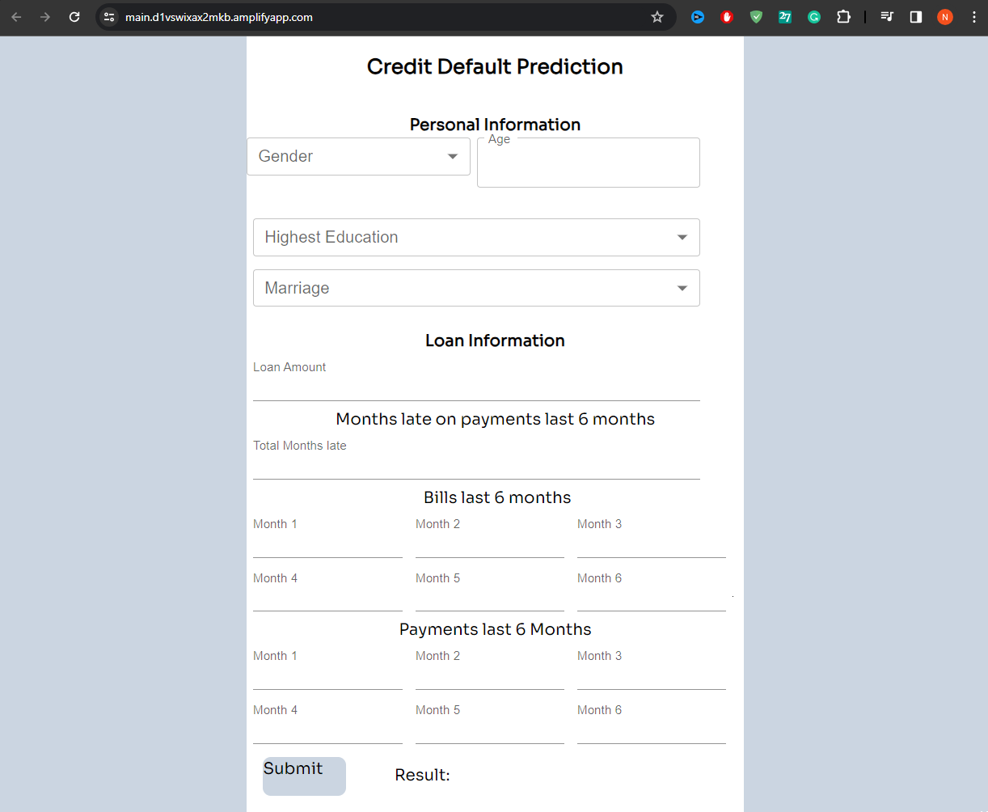
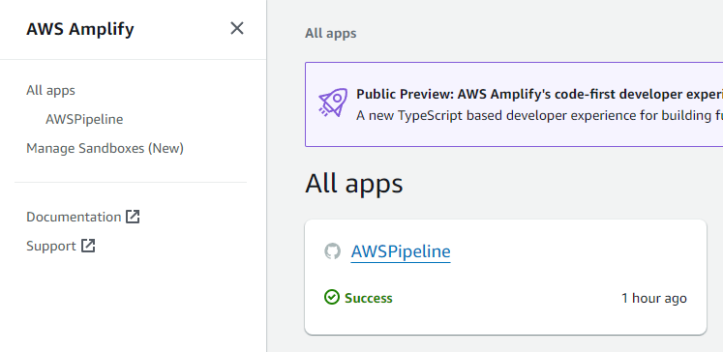
Frontend
The front end of this application is programmed using Node.js and react.js. The application is hosted on AWS amplify.
The webpage can be accessed here

Slide 10
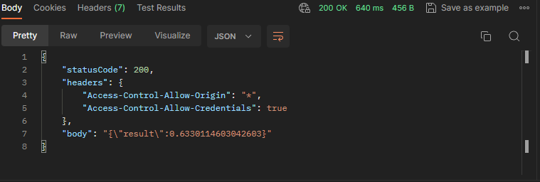
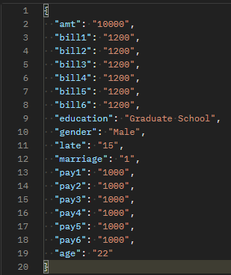
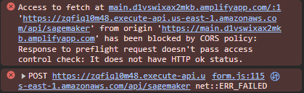
Errors
Currently the application has a flaw that prevents communication between the front and back end. This has to do with a CORS error that we can not seem to find a solution too. If this error did not exist the program would function as intended as the API can be query from an external software such as POSTman and the webpage is fully functional beside not being able to get the result from the model.
CORS error
Postman result
Postman Query

Slide 11
Conclusion
High Accuracy
The model achieved an accuracy of 81.23%, indicating a strong ability to classify instances correctly.
Precision and Error Minimization:
With a precision score of 0.6596 and a Mean Squared Error (MSE) of 0.1412, the model shows effective identification of positive instances and minimizes prediction errors, which is especially important in scenarios where reducing false positives is crucial.
Effective Discrimination Ability:
The Receiver Operating Characteristic (ROC) curve and an Area Under the Curve (AUC) score of 0.77 highlight the model's capacity to distinguish between positive and negative instances effectively across various probability thresholds.

